Slide 1


Slide 2
Agenda
1. What Vue.js is?
2. Vue.js vs Angular 2+ vs React
3. Vue CLI
4. Structure of a Vue.js application
5. Non-UI functionality
6. Components
6.1 Templates
6.2 Text interpolation
6.3 Attribute binding
6.4 Conditional rendering
6.5 List rendering
6.6 Conditional styling
6.7 Event handling
6.8 Custom components
6.9 properties
6.10 Props
6.11 Watchers
6.12 Custom events
6.13 Lifecycle hooks
6.14 Refs
6.15 Slots
7. Custom directives
8. State management
9. Routing
10. Tools

Slide 3
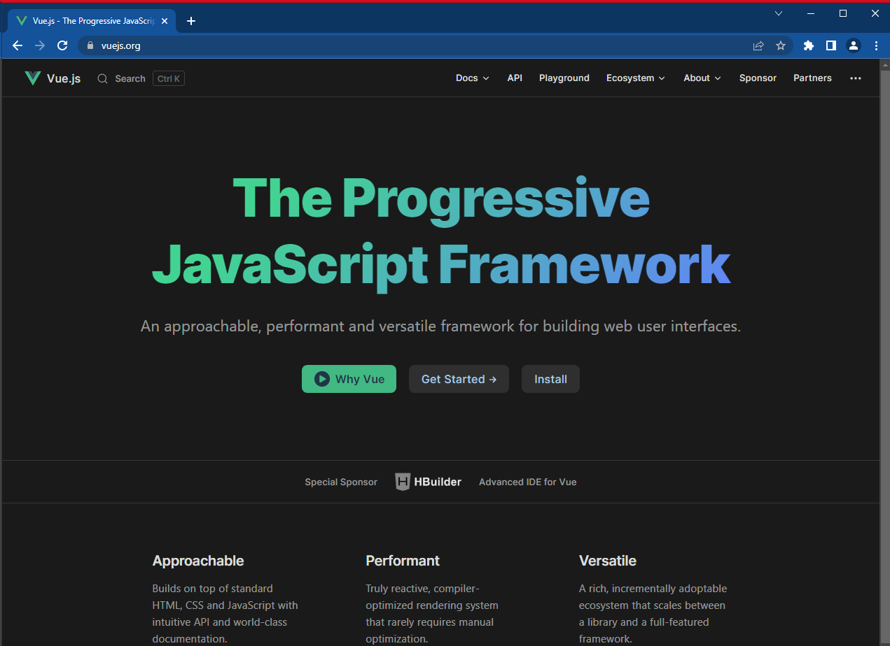
What is Vue.js
Progressive JavaScript Framework for building single page applications
https://vuejs.org/
Version 3
By Evan You

Slide 4
Vue.js vs Angular 2+ vs. React
 | Vue.js | Angular 2+ | React
Version | 3 | 13.x | 17.x
Developed by | Dev Community | Google | Facebook/Meta
Initial release | 2014 | 2010 | 2013
Stars on GitHub | 29.4k | 80.9k | 187k
Programming language | JS/TS | TS | JS
Syntax | Virtual DOM | Real DOM | Virtual DOM
Architecture | Flux | MVC | Flux
Learning curve | Moderate | Steep | Moderate
Performance | Fast | Slow | Normal

Slide 5
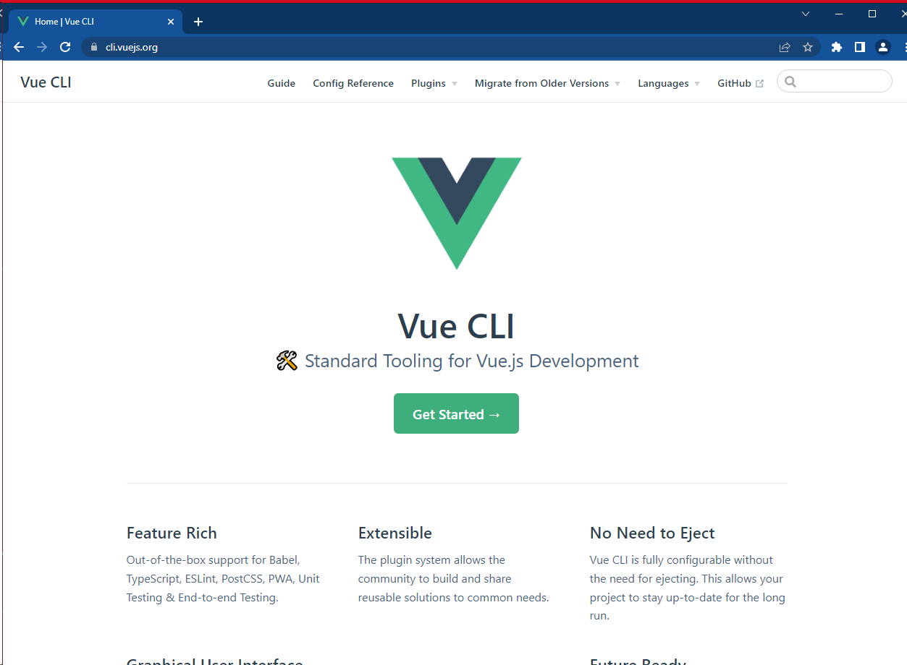
Vue CLI
https://cli.vuejs.org
Create project
Build code
Serve web page
Inspects Webpack configuration
Environment specific configurations
Plugins for ESLint, unit testing, e2e testing, …

Slide 6
Creating a new Vue.js application
> npm init vue@latest
> cd <your-project-name>
> npm install

Slide 7
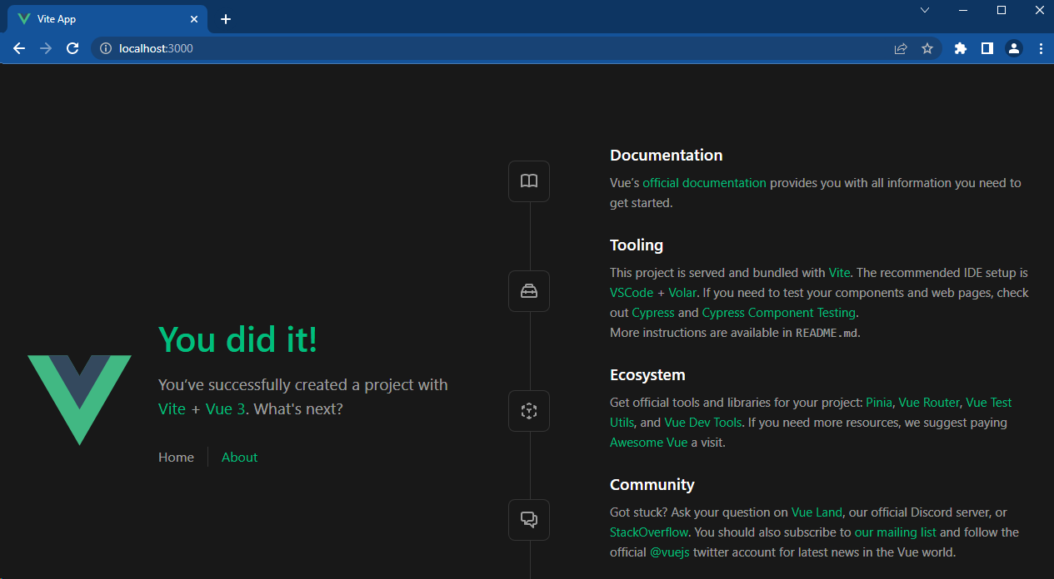
Running a Vue.js application
> npm run serve
or
> npm run dev

Slide 8
Building a Vue.js application
> npm run build -- --target prod

Slide 9
Structure of a Vue.js application
project
|- .env (environment variables)
|- public
|- favicon.ico (app icon)
|- index.html (root page)
|- img
|- images (pwa icons)
|- src
|- assets (global css, icons, images)
|- components
|- main.ts (application entry point)
|- pages
|- registerServiceWorker.ts (service worker event handlers)
|- vue.config.js (vue cli configuration)

Slide 10
Non-UI functionality
Vue.js is only comes with UI functionality!
For additional functionality we need to include external libraries:
Vue Router for routing
Vuex for state management
Axios for HTTP requests
Inversify for dependency injection
…

Slide 11
Components
Page as a top-level component and has a route
Component structure
*.vue (a component file that references the html, ts and scss file)
*.ts (the logic for the component)
*.html (the template for the component)
*.scss (the styling for the component)
We always need to reference the components with the .vue extension!

Slide 12
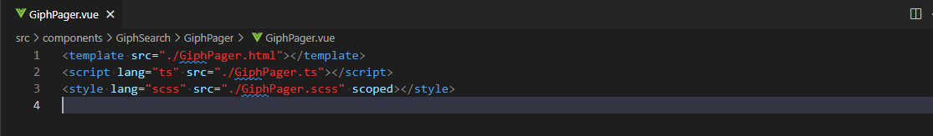
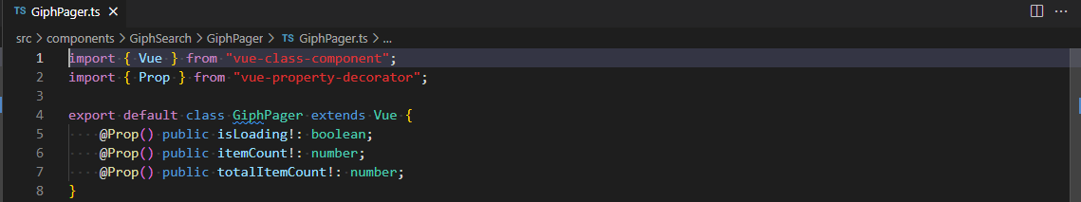
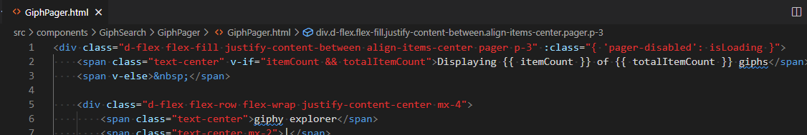
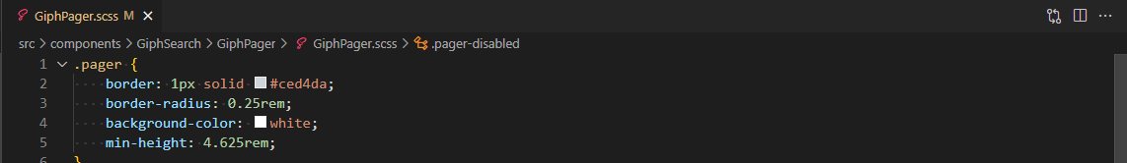
Components: Structure

Slide 13
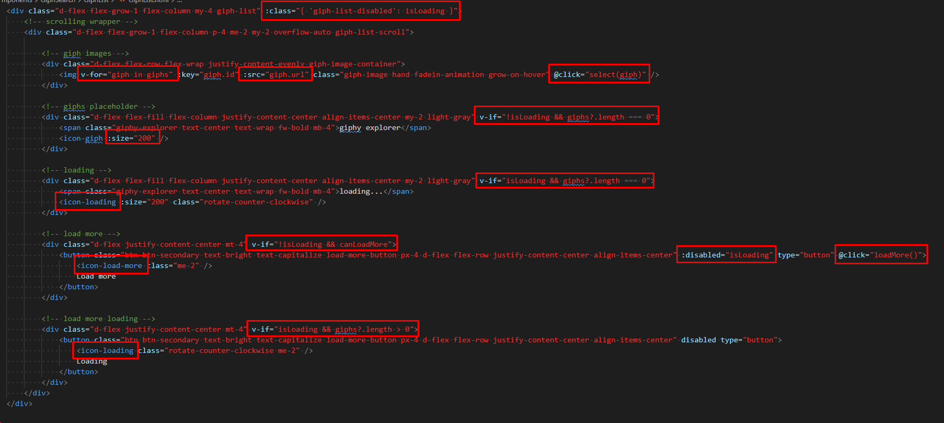
Components: Template
HTML
Text interpolation
Component references
Attribute binding
Event handling
Directives

Slide 14
Components: Text interpolation
Outputting variable values:
{{ myVariable }}
Outputting expressions:
{{ length > 0 ? `${length} items` : “” }}
Output formatting:
{{ toIsoDate(now) }}

Slide 15
Components: Attribute binding
Long: v-bind.attributeName=“expression”
Short: :attributeName=“expression”
Examples:
<img :src="giph?.url” />
<icon-giph :size="200" />
<component :show="itemCount < totalItemCount“ />

Slide 16
Components: Conditional Rendering
v-if=“expression“
v-show=“expression”
Examples:
<div v-if=“title?.length > 0”>{{ title }}</div>

Slide 17
Components: List rendering
v-for=“item in items" :key=“item.id“
v-for=“(item, index) in items” (with index)
v-for=“(value, key) in object” (key/value)
Examples:
<img v-for="giph in giphs"
:key="giph.id"
:src="giph.url“ />

Slide 18
Components: Conditional styling
:class="{ ‘css-class-name’: expression }“
Examples:
:class="{ ‘empty’: count === 0 }“

Slide 19
Components: Event handling
Long: v-on.click=“eventHandler($event)“
Short: @click=“eventHandler($event)“
Examples:
<img @click="select(giph)" />
<input type="text" @keydown.esc="clear()" />
<component @search="onSearch($event)“
@clear="onClear()"></component>

Slide 20
Custom Components
import { Vue } from "vue-class-component";
export default class ComponentAbc extends Vue {
}

Slide 21
Registering Custom Components
Custom components are registered in main.ts:
import "reflect-metadata";
import ComponentAbc from "./ComponentAbc.vue";
…
app.component(“component-abc", ComponentAbc);
Referencing a custom component:
<component-abc :property1=“length” @clear=“onClear()> </component-abc>

Slide 22
Custom Components: Properties
import { Vue } from "vue-class-component";
export default class ComponentAbc extends Vue {
private readonly property1 = “abc”; // cannot bind to in the template
public property2: string; // can bind to in the template
public get property3(): string { // cached property
return this.property1;
}
@inject() private readonly router!: IRouter; // injected value
}

Slide 23
Custom Components: Props
import { Vue } from "vue-class-component";
import { Prop } from "vue-property-decorator";
export default class ComponentAbc extends Vue {
@Prop public property1!: string;
}
Binding to a custom property
<component-abc :property1=“name”></component-abc>

Slide 24
Custom Components: Watchers
import { Vue } from "vue-class-component";
import { Prop, Watch } from "vue-property-decorator";
export default class ComponentAbc extends Vue {
@Prop public property1!: string;
@Watch(“property1", { deep: false })
public onProperty1Changed(newValue: string, oldValue: string): void {
// do something when property1 changes
}
}
}

Slide 25
Custom Components: Custom events
import { Vue } from "vue-class-component";
export default class ComponentAbc extends Vue {
public onSaveClicked(): void {
this.$emit(“save“, { parameter1: true });
}
}
Subscribing to a custom event
<component-abc @save=“onSave($event)”></component-abc>

Slide 26
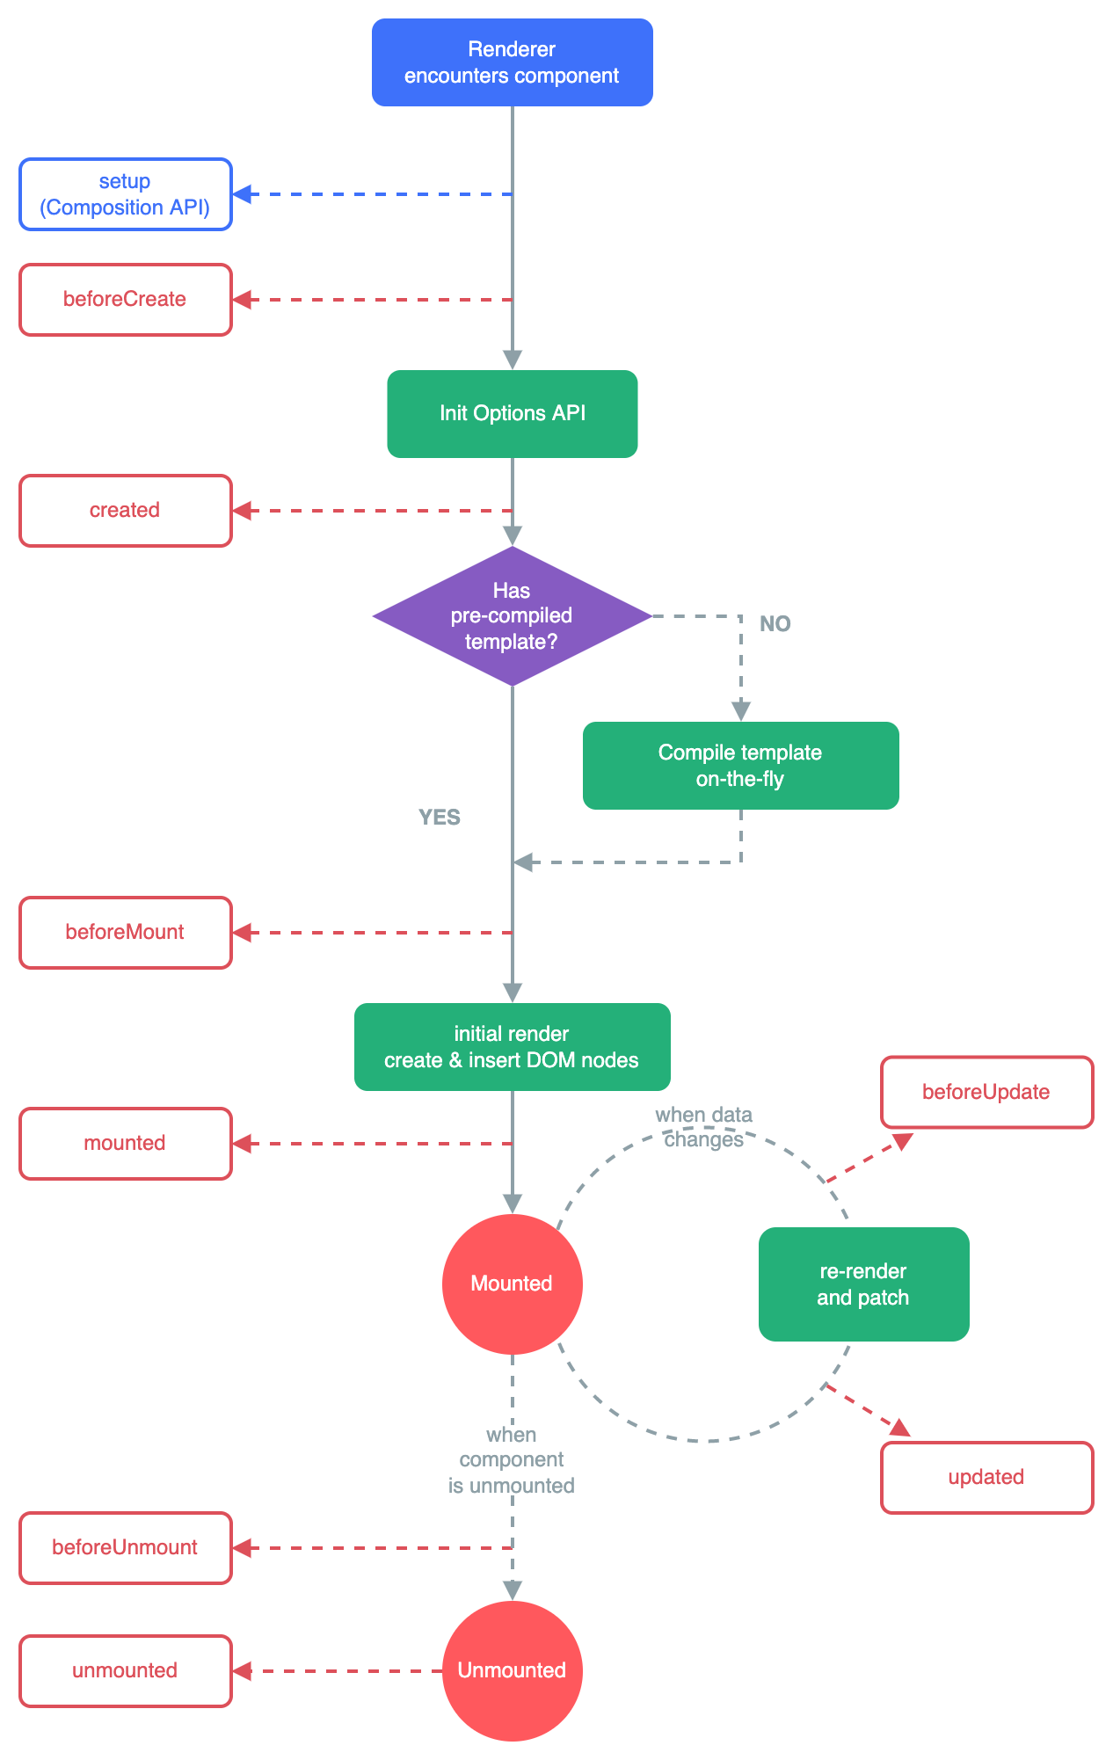
Component Lifecycle Hooks

Slide 27
Handling Lifecycle Hooks
import { Vue } from "vue-class-component";
export default class ComponentAbc extends Vue {
public mounted(): void {
// do something when the component is ready
}
public unmounted(): void {
// do something when the component is destroyed
}
}

Slide 28
Handling Lifecycle Hooks (Async)
import { Vue } from "vue-class-component";
export default class ComponentAbc extends Vue {
public async mounted(): Promise<void> {
// do something async when the component is ready
}
public async mounted(): Promise<void> {
// do something async when the component is destroyed
}
}

Slide 29
Custom Components: Refs
Use ref to specify an element that can be referenced in code:
<input type="text" ref="input“ />
Access the element in code:
import { Vue } from "vue-class-component";
export default class ComponentAbc extends Vue {
private get input(): HTMLInputElement {
return this.$refs.input as HTMLInputElement;
}
}

Slide 30
Custom Components: Slots
Define slot in layout.html:
<div class=“d-flex flex-column align-items-center”>
<slot></slot>
<div>
Specify what the slot will be replaced with in ComponentAbc.html:
<layout>
<h2>{{ title }}</h2>
</layout>

Slide 31
Custom Components: Named slots
Define slot in layout.html:
<div class=“d-flex flex-column align-items-center”>
<div><slot name=“header”></slot></div>
<div>Bla bla</div>
<div><slot name=“footer”></slot></div>
<div>
Specify what the slots will be replaced with in ComponentAbc.html:
<layout>
<template v-slot:header><h2>{{ title }}</h2></template>
<template v-slot:footer>ACME Inc 2022</template>
</layout>

Slide 32
Custom Directives
export const AutoFocusDirective = {
mounted: (el: HTMLInputElement): void => {
el.focus();
}
};
Directive lifecycle hooks:
created (called right before the element is inserted into the DOM),
beforeMount (called when the bound element's parent component and all its children are mounted),
mounted (called before the parent component is updated),
beforeUpdate (called after the parent component and all of its children have updated),
updated (called before the parent component is unmounted),
beforeUnmount (called when the parent component is unmounted)
unmounted

Slide 33
Registering Custom Directive
Custom directives are registered in main.ts:
import { AutoFocusDirective } from "./AutoFocusDirective";
…
app.directive("auto-focus", AutoFocusDirective);
Referencing a custom component:
<input type="text" v-auto-focus />

Slide 34
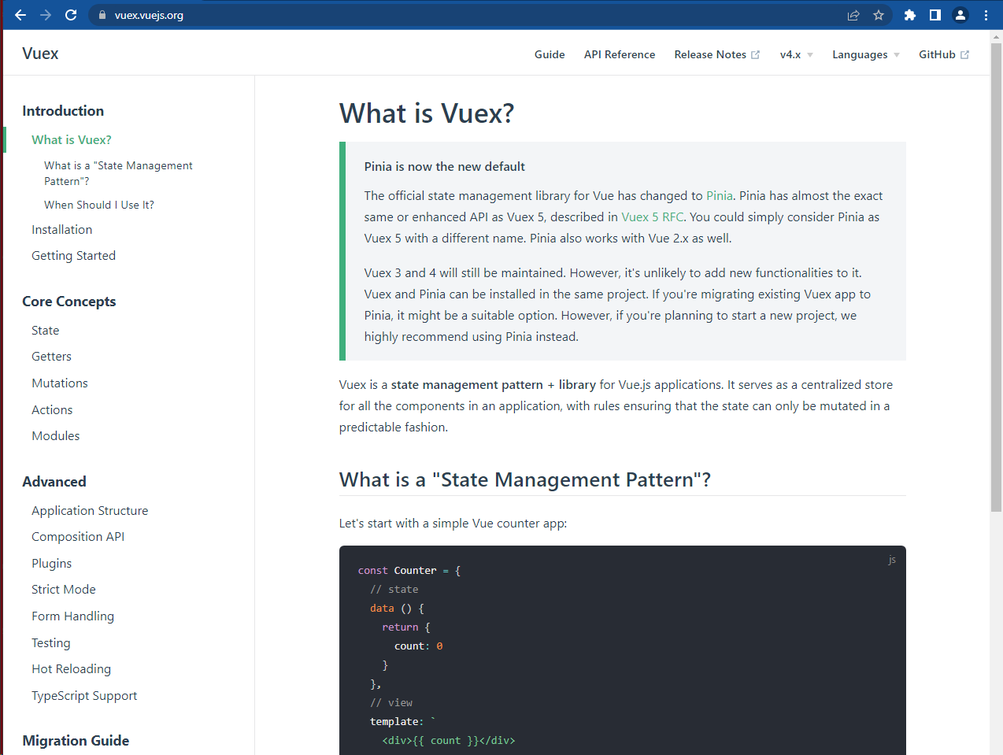
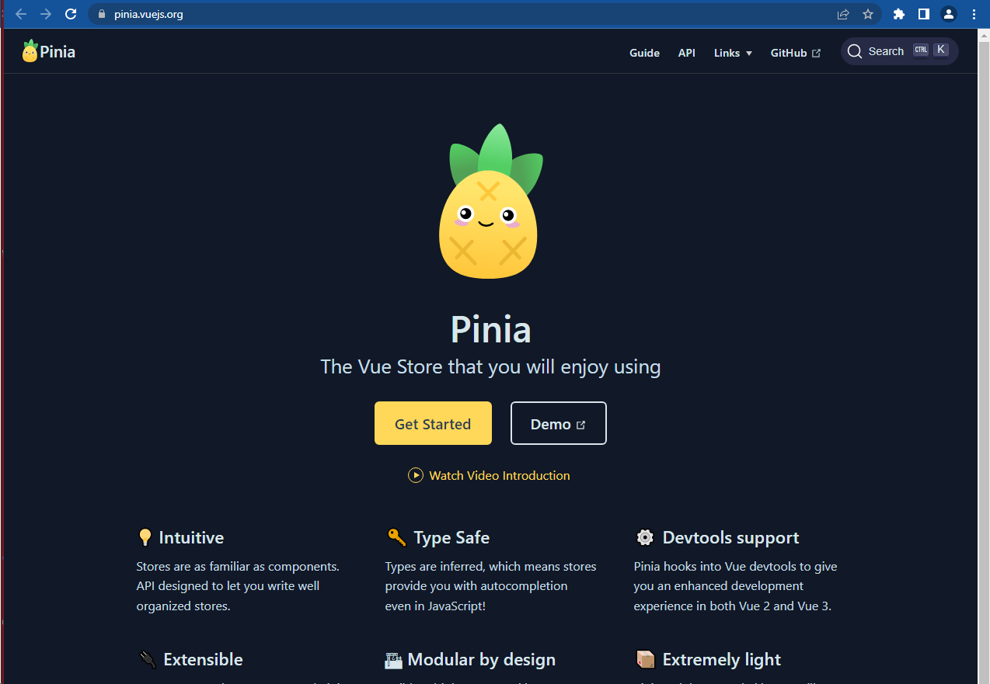
Plugins: State Management
Vuex: https://vuex.vuejs.org/
Pinia: https://pinia.vuejs.org/
Actions
View
State

Slide 35
State Management: Register Store
Plugins are registered in main.ts:
import { store } from "./state/store";
…
app.use(store);

Slide 36
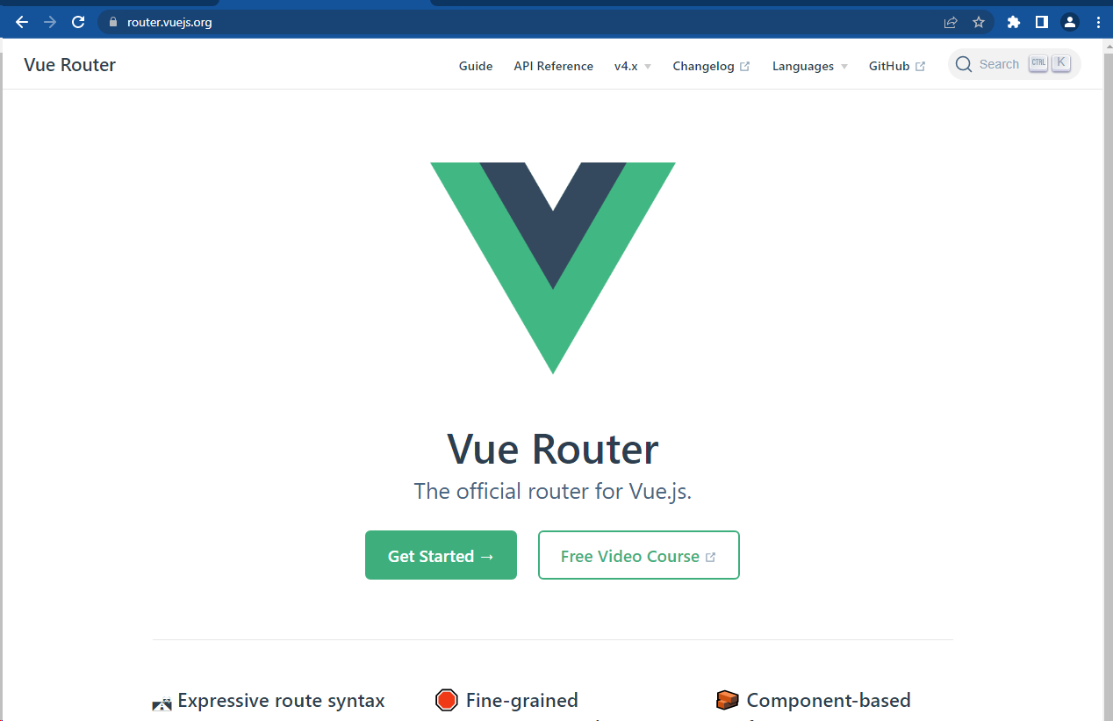
Plugins: Routing
Vue Router
https://router.vuejs.org/

Slide 37
Routing: Declaring Routes
import { createRouter, createWebHashHistory } from "vue-router";
const router = createRouter({
history: createWebHashHistory("/"),
routes: [
{ path: "/", name: "Default", redirect: "/search" },
{ path: "/search", name: “Search”, component: GiphSearch },
{ path: "/details/:giphId", name: “Details”, component: GiphDetails },
{ path: "/:catchAll(.*)", redirect: "/search" }
]
});

Slide 38
Routing: Register Routes
Plugins are registered in main.ts:
import router from "./router/routing";
…
app.use(router);
…
router.isReady().then(() => app.mount("#app"));

Slide 39
Routing: Working with routes
Check active route:
useRoute()?.name === “route name”
Navigate to route:
this.router.push({ name: “route name” });
Navigate to route with a parameter:
this.router.push({ name: “route name”, params: { abc: “xyz” } });
Getting route parameter:
this.router.currentRoute.value.params.abc as string

Slide 40
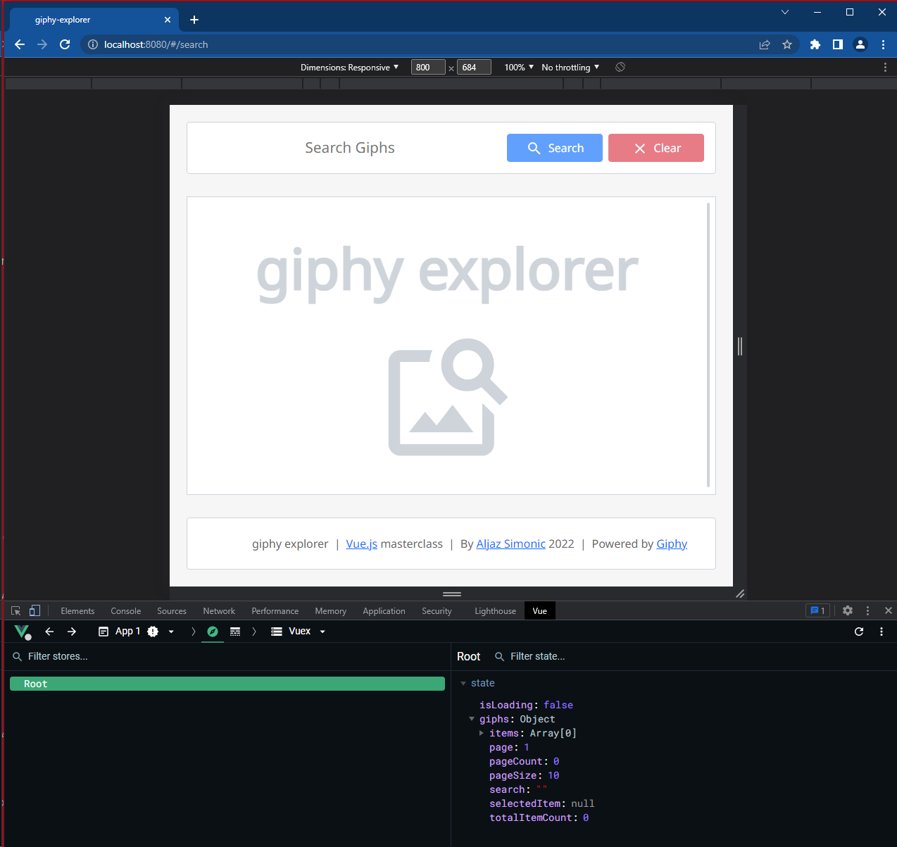
Tools: Vue.js devtools
Chrome plugin
Inspect components
Inspect application state
Inspect application routes

Slide 41
Thank you!

